Slide 1

Tech Tuesday
En grunnleggende innføring I CAF Enterprise Scale Landing Zones

Slide 2
Agenda
Praktisk info
Viktige begreper
Hva er CAF?
Hva er ESLZ?
Referansedesign
Forskjellige implementeringsmetoder (hvis tid)

Slide 3
Praktisk info
Lunsj: Dagens wrap med drikke.
Varighet: 11:00 – 11:45 (offisielt)
Deretter har vi 15 min for de som vil / har tid.
Spis lunsjen underveis.
Vi har dedikert Q&A etter presentasjon for litt større diskusjoner.
…men jeg foretrekker ofte å få spørsmål direkte etter tema er presentert.
Vi kan ta korte spørsmål underveis.

Slide 4
Viktige begreper
Landing Zone
Enterprise Scale
Hub-Spoke
Policy-driven Management
Policy-as-Code
Referansedesign
Well-Architected Framework
Notes:
Landing Zone – En landingssone for dine applikasjoner og workloads. Skilles mellom online og corporate connected.
Azure landing zones are the output of a multisubscription Azure environment that accounts for scale, security governance, networking, and identity. Azure landing zones enable application migration, modernization, and innovation at enterprise-scale in Azure. These zones consider all platform resources that are required to support the customer's application portfolio and don't differentiate between infrastructure as a service or platform as a service.
Enterprise Scale – Skala-begrepet som gjør at man kan skalere uten at organisasjonen nødvendigvis trenger å ansette flere teknikere I drift.
Hub-Spoke Topologi – Nettverksbegrep hvor det er en sentral hub med delte ressurser. All nettverkstrafikk skal da gå gjennom denne hub-en.
Policy-driven Management – Innebærer at mye administrasjon gjøres av policy, og ikke manuelt eller med ad hoc IaC. Blant annet aktivering av diagnostic settings til Log Analytics Workspace.
Policy-as-Code – ARM/Bicep + GitHub for å sette RBAC på mgmt. group/subscription/resource group. Samme for å oppdatere Azure Policies.
Referansedesign – Trey research, WingTip, Adventureworks, Contoso
Well-Architected Framework – Reliability, Security, Cost Optimization, Operational Excellence, Performance Efficiency

Slide 5
Hva er Cloud Adoption Framework?
Dokumentasjon
Implementasjonsveiledninger
Beste praksiser
Verktøy
Beviselig veiledning
Notes:
The Cloud Adoption Framework is a collection of documentation, implementation guidance, best practices, and tools that are proven guidance from Microsoft designed to accelerate your cloud adoption journey.
By using the Cloud Adoption Framework for Azure best practices, organizations can better align their business and technical strategies to ensure success.
Affected roles:
Line-of-business leaders
Business decision makers
IT decision makers
Finance
Enterprise administrators
IT operations
IT security and compliance
IT governance
Workload development owners
Workload operations owners
Cloud Architect - The cloud architect serves as the thought leader and facilitator to bring these audiences together. We've designed this collection of guides to make it easier for cloud architects to have the right conversations with the right audiences and drive decision-making. Business transformation that's empowered by the cloud depends on the cloud architect role to help guide decisions throughout the business and IT.

Slide 6
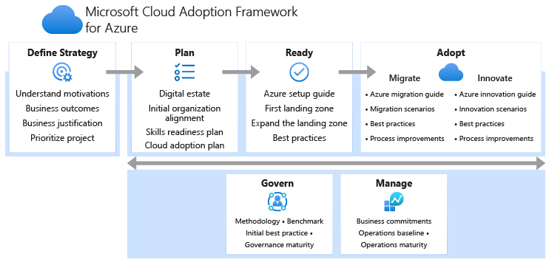

Slide 7
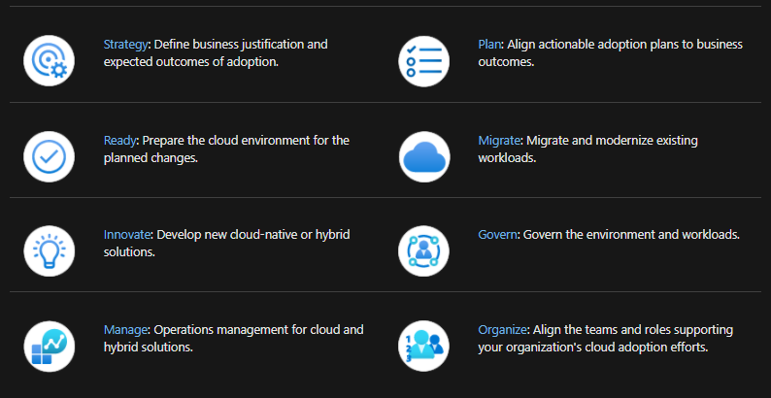

Slide 8
Hva er Enterprise Scale Landing Zones?
Strategiske designvalg
Kontinuerlig oppdatert
Modulær tilnærming
Start smått hvis ønskelig
Befinner seg i “Ready” under CAF-rammeverket
Beregnet på å definere plattformen man skal etablere i Azure
Policy-driven management
Mindre administrativ overhead
Automatisert ops
Notes:
The enterprise-scale architecture represents the strategic design path and target technical state for your Azure environment. It will continue to evolve alongside the Azure platform and is defined by the various design decisions that your organization must make to map your Azure journey
Not all enterprises adopt Azure in the same way, so the Cloud Adoption Framework for Azure enterprise-scale landing zone architecture varies between customers. The technical considerations and design recommendations of the enterprise-scale architecture might lead to different trade-offs based on your organization's scenario. Some variation is expected, but if you follow the core recommendations, the resulting target architecture will set your organization on a path to sustainable scale.
The enterprise-scale architecture is modular by design. It allows you to start with a foundational landing zone control plane that support your application portfolios, no matter whether the applications are being migrated or are newly developed and deployed to Azure. The architecture can scale alongside your business requirements regardless of scale point.
The enterprise-scale approach to construct landing zones includes three sets of assets to support cloud teams:
Design guidelines: Guide to the critical decisions that drive the design of the Cloud Adoption Framework for Azure enterprise-scale landing zone.
Architecture: Conceptual reference architecture that demonstrates design areas and best practices.
Implementations: Azure Resource Manager template of the architecture to accelerate adoption.

Slide 9
Environment design areas
Design areas | Objective | Relevant methodologies
Azure billing and Active Directory tenant | Proper tenant creation, enrollment, and billing setup are important early steps. | Ready
Identity and access management | Identity and access management is a primary security boundary in the public cloud. It's the foundation for any secure and fully compliant architecture. | Ready
Network topology and connectivity | Networking and connectivity decisions are an equally important foundational aspect of any cloud architecture. | Ready
Resource organization | As cloud adoption scales, considerations for subscription design and management group hierarchy have an impact on governance, operations management, and adoption patterns. | Govern
Notes:
https://docs.microsoft.com/en-us/azure/cloud-adoption-framework/ready/landing-zone/design-areas
Regardless of the deployment option, you should carefully consider each design area. Your decisions affect the platform foundation on which each landing zone depends.

Slide 10
Compliance design areas
Design areas | Objective | Relevant methodologies
Governance | Automate auditing and enforcement of governance policies. | Govern
Security | Implement controls and process to protect your cloud environments | Secure
Management | For stable, ongoing operations in the cloud, a management baseline is required to provide visibility, operations compliance, and protect and recover capabilities. | Manage
Platform automation and DevOps | Align the best tools and templates to deploy your landing zones and supporting resources. | Ready
Notes:
https://docs.microsoft.com/en-us/azure/cloud-adoption-framework/ready/landing-zone/design-areas
Security, governance, and compliance are key topics when designing and building an Azure environment, not only to start from strong foundations, but also to ensure solid ongoing processes and controls are in place. Alongside the controls that help maintain and demonstrate compliance, the tools and processes implemented for managing environments play an important role in detecting and responding to issues that require action.

Slide 11
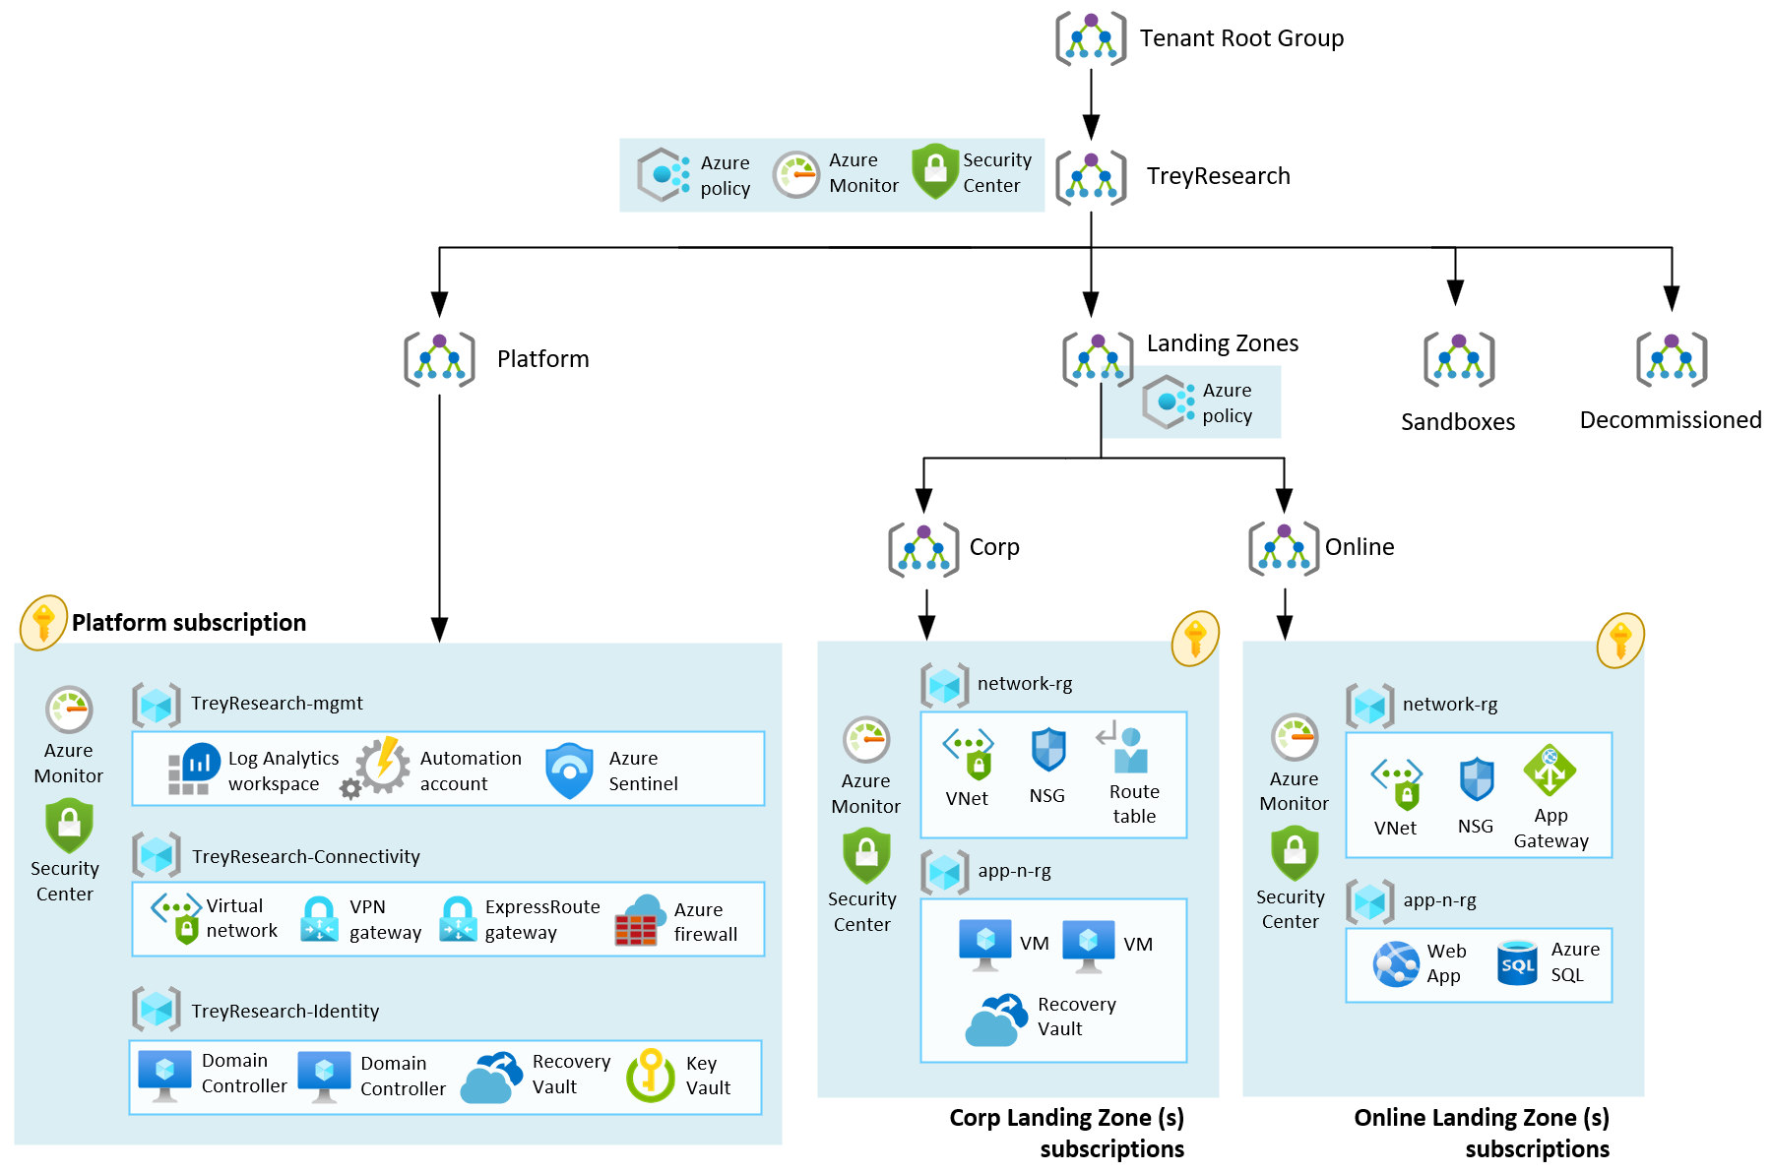
Referansedesign: Trey Research
Notes:
https://github.com/Azure/Enterprise-Scale/blob/main/docs/reference/treyresearch/README.md
Simple start for small enterprises or businesses.
Online only
No corp connectivity
This reference implementation provides a design path and initial technical state for Small and Medium Enterprises to start with foundational landing zones that support their application portfolios. This reference implementation is meant for organizations that do not have a large IT team and do not require fine grained administration delegation models. Hence, Management, Connectivity and Identity resources are consolidated in a single Platform Subscription.

Slide 12
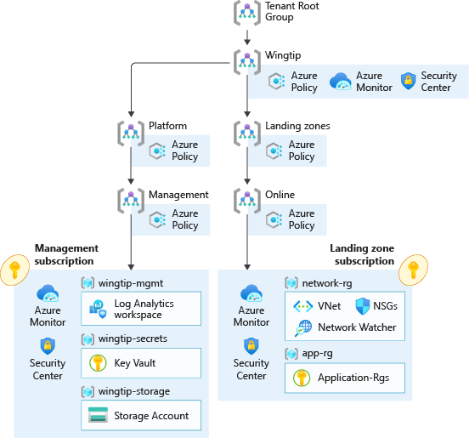
Referansedesign: WingTip
Notes:
https://github.com/Azure/Enterprise-Scale/blob/main/docs/reference/wingtip/README.md
Small enterprises with soon-ish plans for expansion to hub-spoke.
This reference implementation is ideal for customers who want to start with Landing Zones for their workloads in Azure, where hybrid connectivity to their on-premises datacenter is not required from the start.
More easily expandable

Slide 13
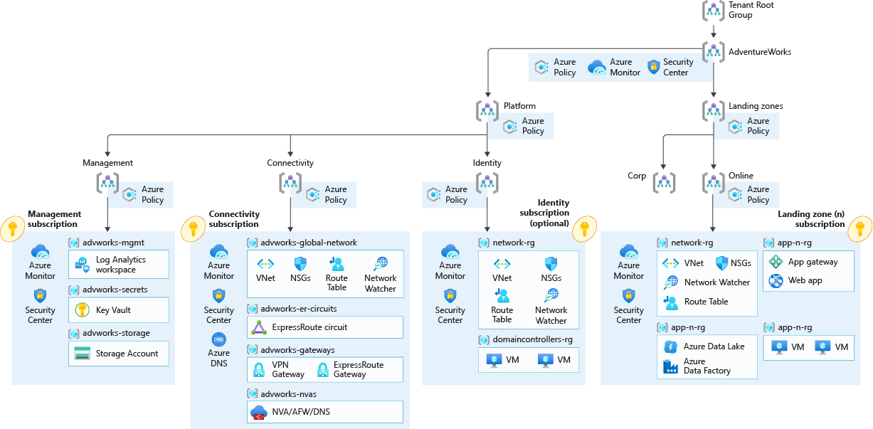
Referansedesign: AdventureWorks
Notes:
https://github.com/Azure/Enterprise-Scale/blob/main/docs/reference/adventureworks/README.md
Enterprises with need for corporate connectivity and full blown hub-spoke.
A hub and spoke network topology allows you to create a central Hub VNet that contains shared networking components (such as Azure Firewall, ExpressRoute and VPN Gateways) that can then be used by spoke VNets, connected to the Hub VNet via VNET Peering, to centralize connectivity in your environment. Gateway transit in VNet peering allows spokes to have connectivity to/from on-premises via ExpressRoute or VPN, and also, transitive connectivity across spokes can be implemented by deploying User Defined Routes (UDR) on the spokes and using Azure Firewall or an NVA in the hub as the transit resource.

Slide 14
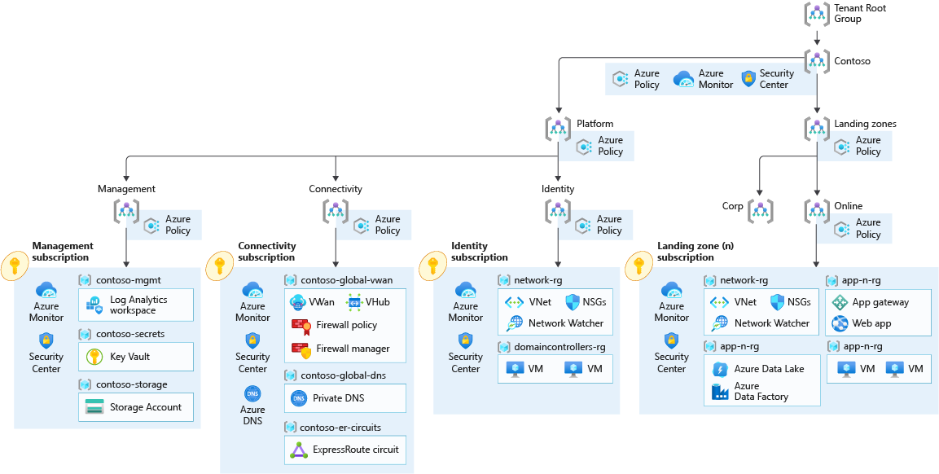
Referansedesign: Contoso
Notes:
https://github.com/Azure/Enterprise-Scale/blob/main/docs/reference/contoso/Readme.md
Enterprises with need for hub-spoke and full blown global Azure vWan configuration. Auto-peerings.
Azure Virtual WAN is a Microsoft-managed solution that provides end-to-end, global, and dynamic transit connectivity by default. Virtual WAN hubs eliminate the need to manually configure network connectivity. For example, you don't need to manage user-defined routes (UDR) or network virtual appliances (NVAs) to enable global transit connectivity. Virtual WAN simplifies end-to-end network connectivity in Azure, and to Azure from on-premises, by creating a hub-and-spoke network architecture.

Slide 15
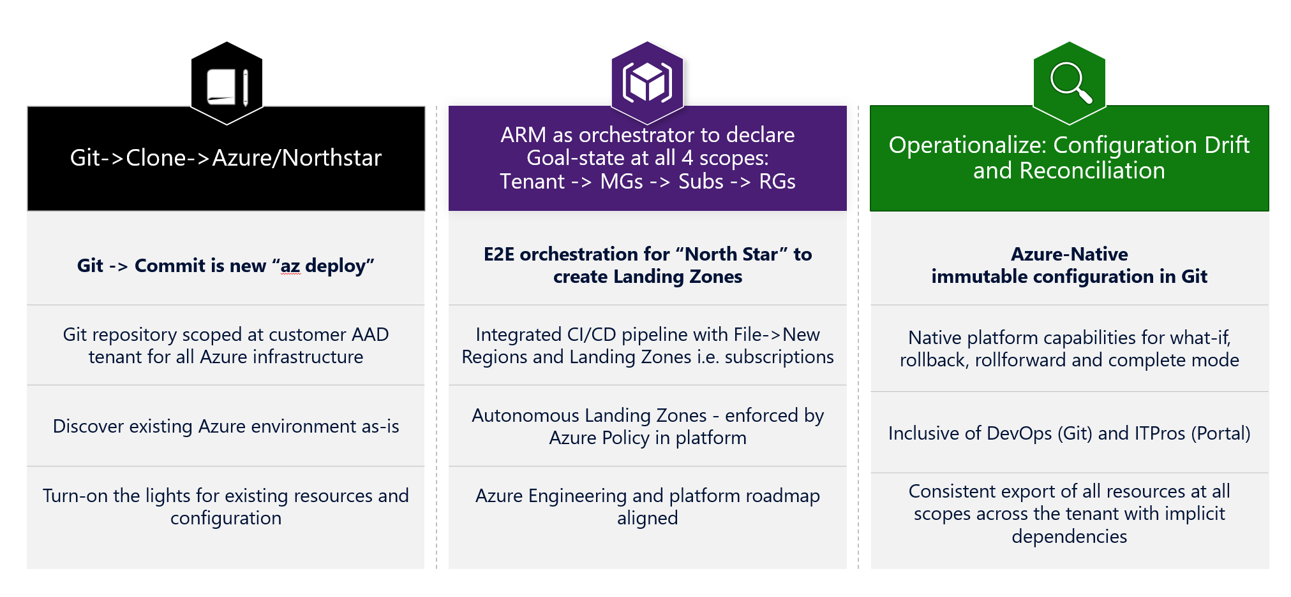
AzOps
https://github.com/Azure/AzOps
AzOps is a PowerShell module which deploys (Push) Resource Templates & Bicep files at all Azure scope levels and exports (Pull) ARM resource hierarchy.
Notes:
GitHub repo -> Management Groups -> Subscriptions -> Resource Groups
Automatisk import av eksisterende Azure hierarki/topologi.
Deploy av ressurser i forskjellige scopes, både med ARM og Bicep

Slide 16
“Antipatterns”
Assume released services are ready for production
Example: Use a preview service in production
Preferred outcome: Use pre-approved cloud services in production
Assume increased resiliency and availability
Example: Assume high availability
Preferred outcome: Reduce failures while balancing resiliency and costs
Become a cloud provider
Example: Provide monolithic managed cloud services
Preferred outcome: Provide guardrails

Slide 17
Demo!
Etablere enkelt referansedesign med Terraform
Etablere enkelt referansedesign med portalen
Etablere enkelt referansedesign med ARM Templates/Bicep

Slide 18
Kilder til informasjon
Microsoft Learn
https://docs.microsoft.com/en-us/azure/cloud-adoption-framework/
https://docs.microsoft.com/en-us/azure/cloud-adoption-framework/ready/landing-zone/
https://docs.microsoft.com/en-us/azure/cloud-adoption-framework/ready/enterprise-scale/
GitHub (Microsoft)
https://github.com/Azure/Enterprise-Scale
https://github.com/Azure/Enterprise-Scale/blob/main/docs/EnterpriseScale-Deploy-reference-implentations.md
https://github.com/Azure/ResourceModules
https://techcommunity.microsoft.com/t5/azure-migration-and/your-target-end-state-azure-landing-zones-conceptual/ba-p/2898577
AzOps: https://github.com/azure/azops/wiki/introduction
AzOps Accelerator: https://github.com/azure/azops-accelerator
https://github.com/Azure/Enterprise-Scale/wiki
SMART: https://docs.microsoft.com/en-us/azure/cloud-adoption-framework/plan/smart-assessment

Slide 19
Takk for meg!
Spørsmål?
Kommentarer?
Forslag til neste tema?

